Slide 1
MEDICINES & SIDE EFFECT ANALYSIS
TEAM
LOKESH.P
K.B. TIRUMALA RAYA
ARPIT JAIN
ARUNA.Y
PAVITHRA.G
SANDHYA RANI
YAMINI.R
FACULTY GUIDE
VINOD
HIMAVANTH

Slide 2
BUSINESS PROBLEM
THE CUSTOMERS ARE FACING AN ISSUE IN SELECTING A DRUG TO RECOVER FROM THE ILLNESS. HENCE IT IS MANDATORY TO CONSULT A DOCTOR TO GET THE CORRECT DRUG.
BUSINESS OBJECTIVE
This product could be helpful for companies like 1mg to provide detailed rating of the side effects of the product over their site. It could also be helpful for the patients who are buying drugs online to check the side effects of the drugs before buying it.

Slide 3
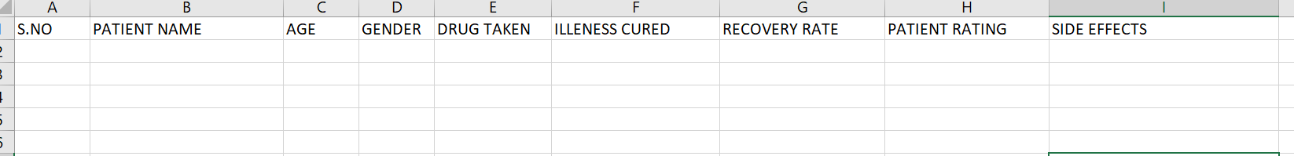
DATA SET DETAILS

Slide 4
PROJECT FLOW
Step-1 : Data set details collection
Step-2 : Data cleaning
Step-3 : EDA phase
Step-4 : Models Building(Build as many as u can)
Step-5 : After evaluating each model identify errors in each model and based on accuracy, f1 score, precision and recall finalize best model.
Step-6 : Compare actual and predicted values.
Step-7 : Deploy the finalized model and draw insights for that.(USING FLASK)

Slide 5
MODEL BUILDING
TEXT MINING
We are using text mining in order to associate the side effects related to a particular drug.
NAIVE BAYES
We are using Naive Bayes for extracting the correct information from the customer's review.

Slide 6
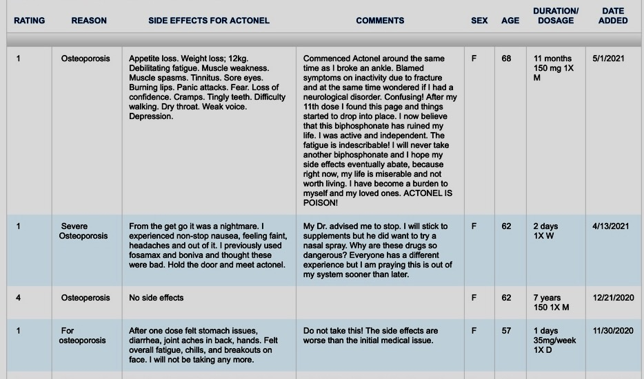
PREDICTED OUTPUT

Slide 7

THANK YOU

